Slide 1

DEPARTMENT OF
ARTIFICIAL INTELLIGENCE AND DATA SCIENCE
ACADEMIC YEAR 2025 - 2026
SEMESTER III
ARTIFICIAL INTELLIGENCE LABORATORY
MINI PROJECT REVIEW
Constraint Satisfaction Approaches for Timetable Scheduling
REGISTER NUMBER | 2117240070037
NAME | Bharat T
YEAR | 2
SECTION | A
FACULTY IN-CHARGE | Mrs. M. Divya

Slide 2
PROBLEM STATEMENT
Timetable scheduling is a complex problem in educational institutions.
It involves assigning courses, teachers, rooms, and time slots such that no conflicts occur.
Objectives:
Prevent teacher and student scheduling conflicts
Ensure room capacity and availability
Automatically generate feasible timetables
The goal is to apply Constraint Satisfaction Problem (CSP) techniques to produce valid, optimized timetables efficiently.

Slide 3
THEORETICAL BACKGROUND
A Constraint Satisfaction Problem (CSP) consists of:
Variables: Courses to be scheduled
Domains: Possible (TimeSlot, Room) combinations
Constraints: No teacher, room, or student overlap
Algorithms Used:
Backtracking Search – explores all possible assignments
Forward Checking – eliminates inconsistent future values early
AC-3 (Arc Consistency) – enforces consistency between variable domains
These methods ensure conflict-free scheduling while minimizing search effort.

Slide 4
IMPLEMENTATION AND CODE
Link to code in Git-hub Repository
List | Git-hub Repository Links
Implementation of Code Link | https://github.com/b-harat-5/AI_Mini_Project/blob/main/Source%20code
Word Document Report Link | Link
PPT Link

Slide 5
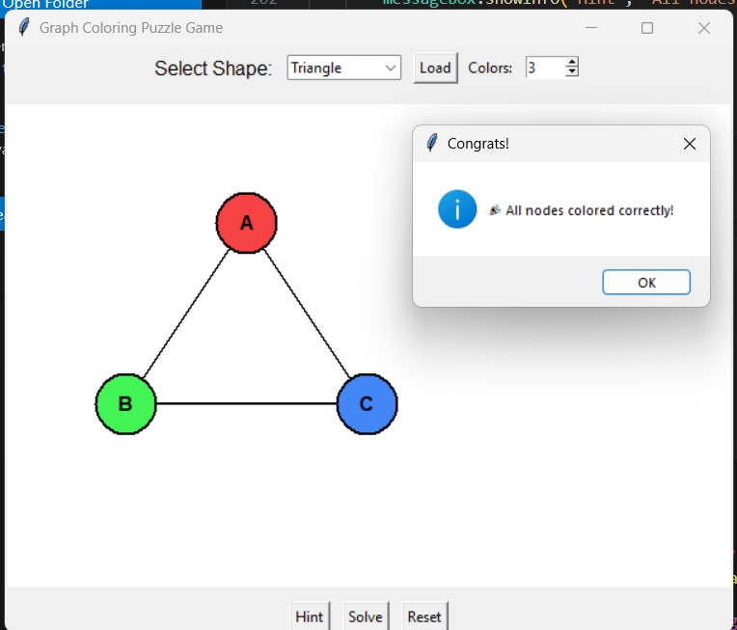
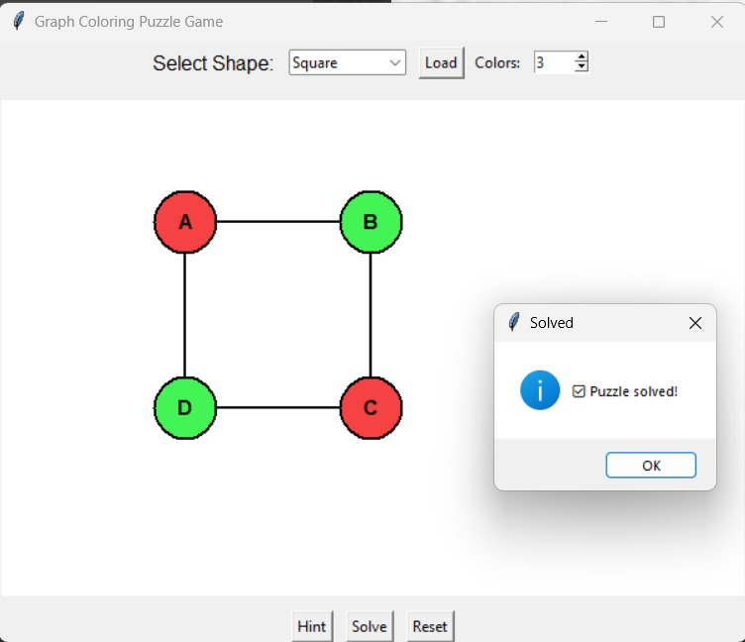
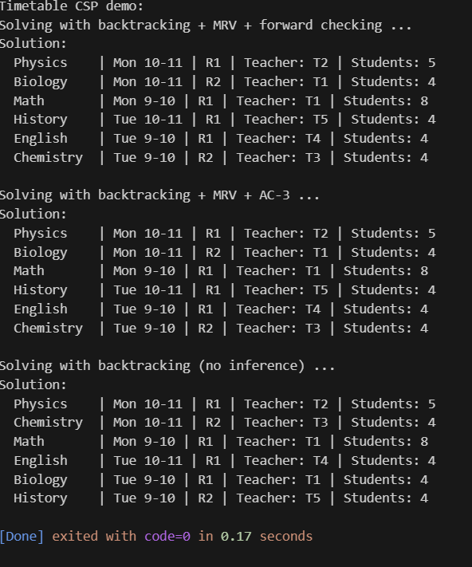
OUTPUT AND RESULTS

Slide 6
OUTPUT AND RESULTS
Conflict-free scheduling achieved
All constraints satisfied
Efficient timetable generation using CSP heuristics

Slide 7
REFERENCES
Russell, S. J., & Norvig, P. (2022). Artificial Intelligence: A Modern Approach.
Dechter, R. (2003). Constraint Processing. Morgan Kaufmann.
Kumar, V. (1992). Algorithms for Constraint-Satisfaction Problems. AI Magazine.
Barták, R. (1999). Constraint Programming: In Pursuit of the Holy Grail.
Tsang, E. (1993). Foundations of Constraint Satisfaction. Academic Press.

